Slide 1


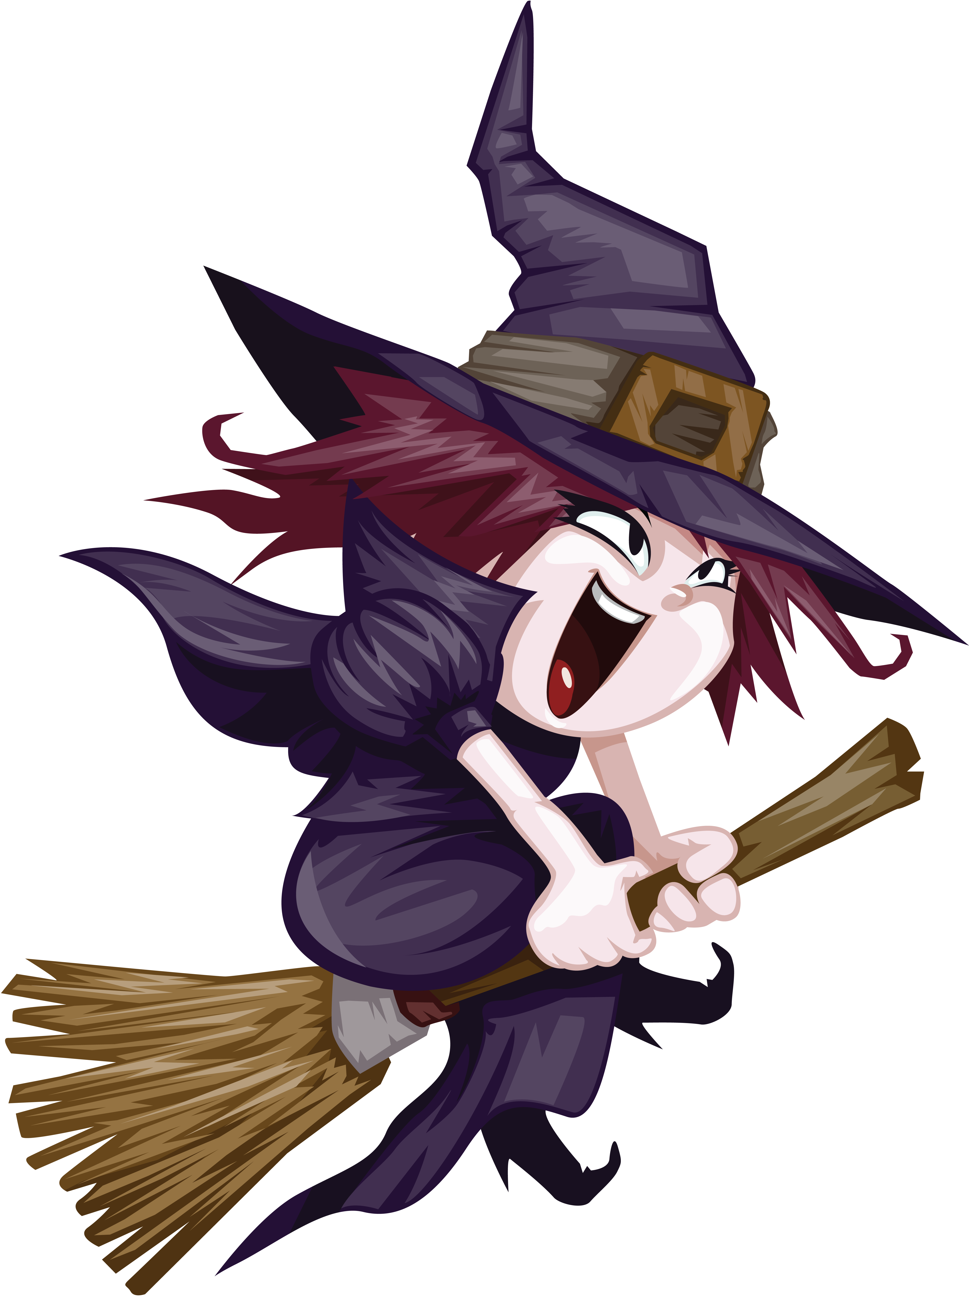
Vasen Vampire
Wanda Witch
Vasen Vampire only teaches at night. His specialties are the Fangdango and the Bat Boogie.
Wanda Witch loves to brew up new dance moves. Her specialties are the Spider Side Step and the Broom Ballet.
This Photo by Unknown Author is licensed under CC BY-NC
This Photo by Unknown Author is licensed under CC BY-NC

Slide 2


Igor’s Dance Class
Schedule
8:30 am Broom Ballet
9:00 am Dungeon Dance
10:00 am Jerky Jitterbug
1:00 pm Werewolf Waltz
2:30 pm Monster Mash
10:00 pm The Fangdango
Fun Frankie
Fun Frankie shows the stiff way to swing. His specialties are the Halting Hop and the Jerky Jitterbug.
This Photo by Unknown Author is licensed under CC BY-NC
This Photo by Unknown Author is licensed under CC BY-NC

Slide 3
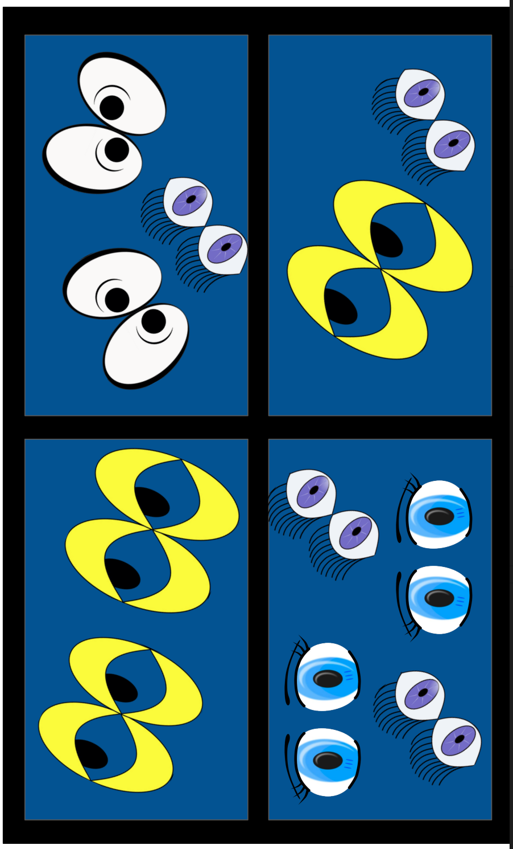
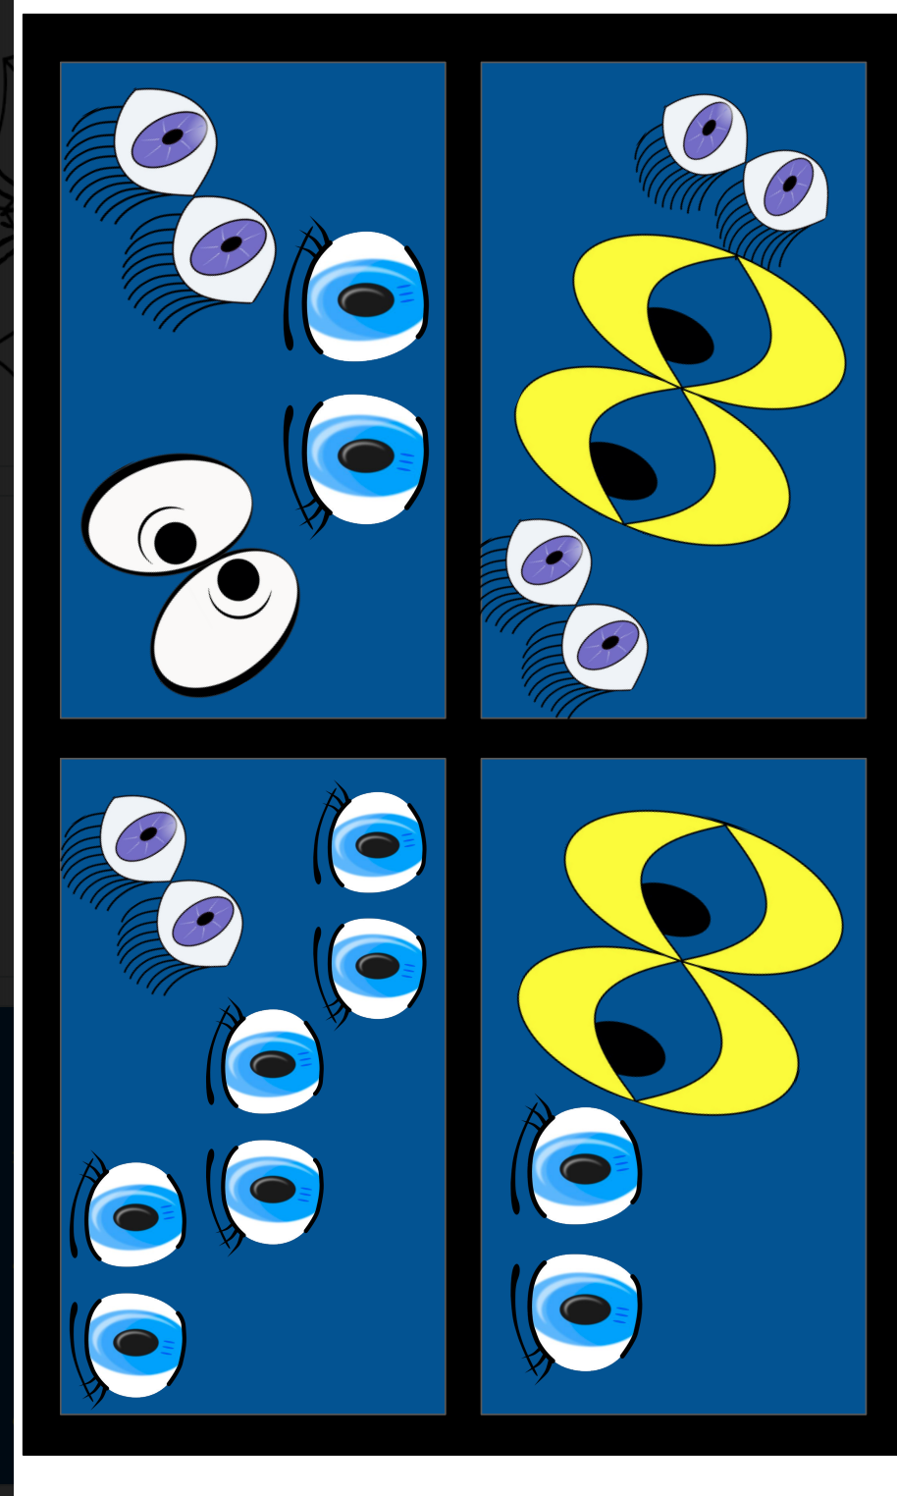
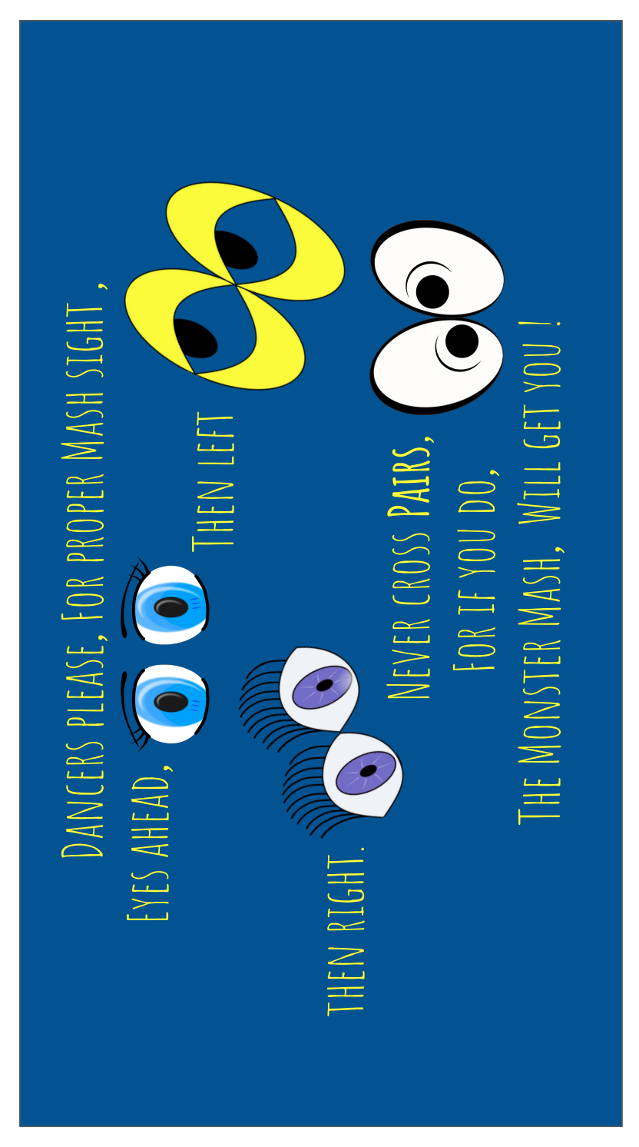

Slide 4
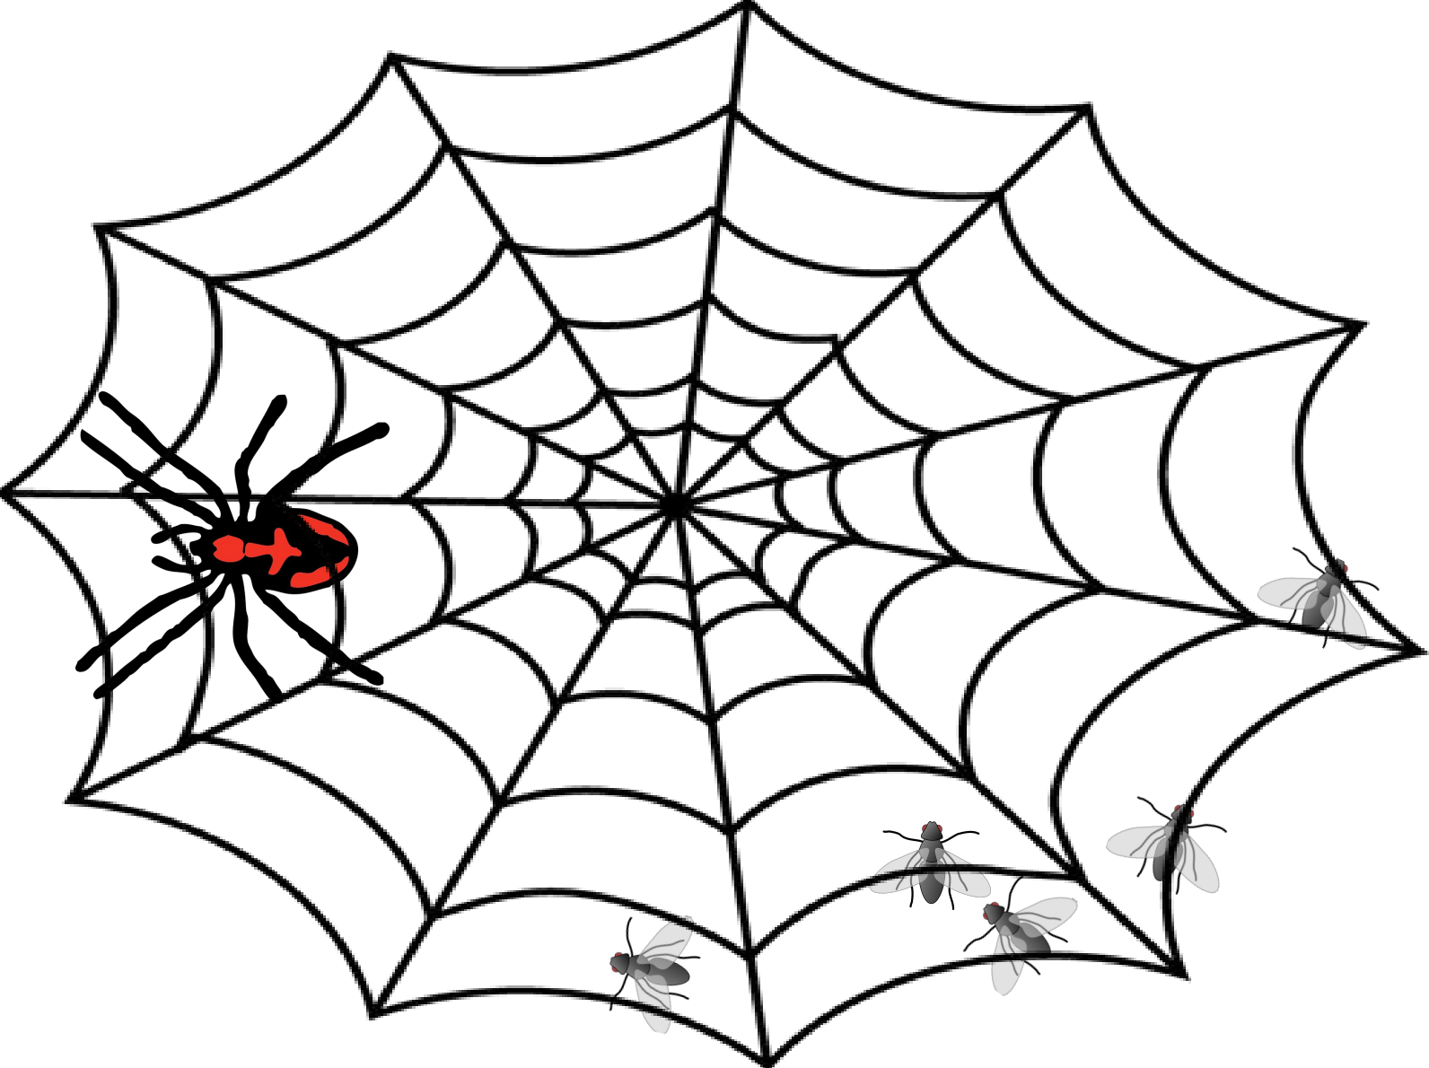
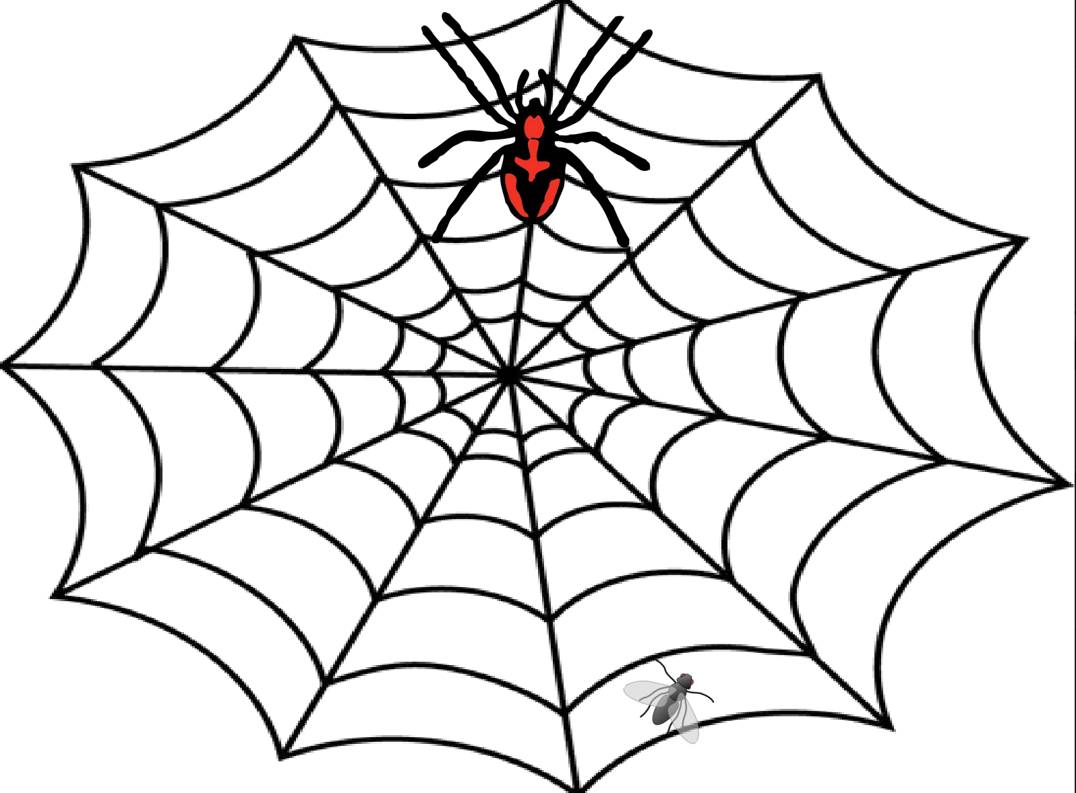

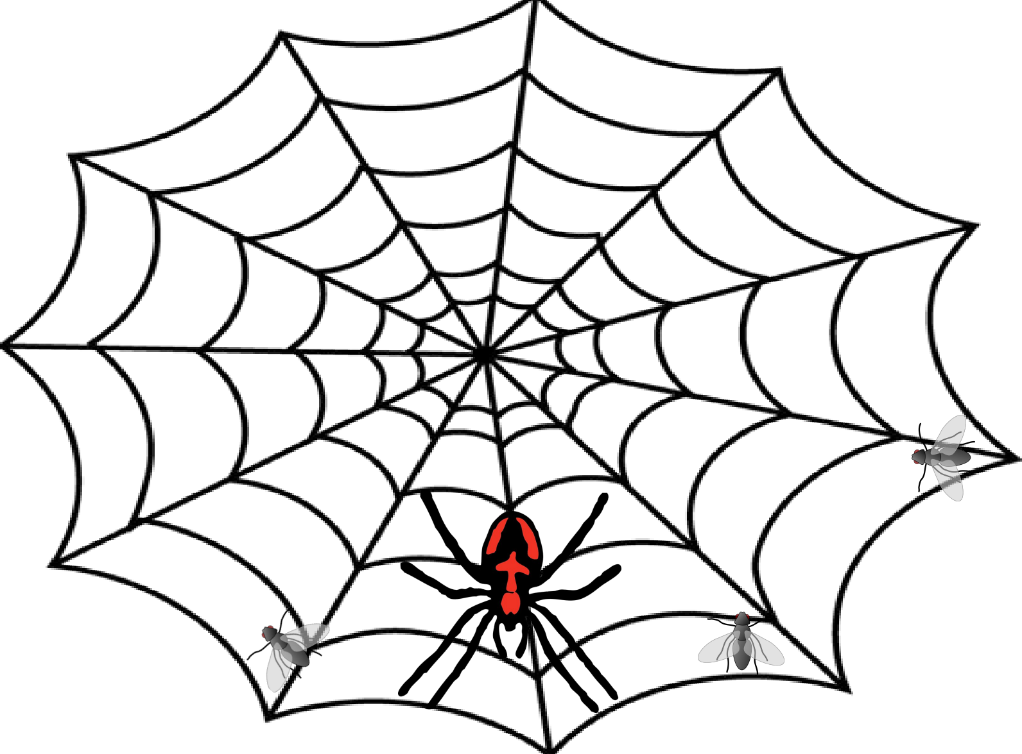
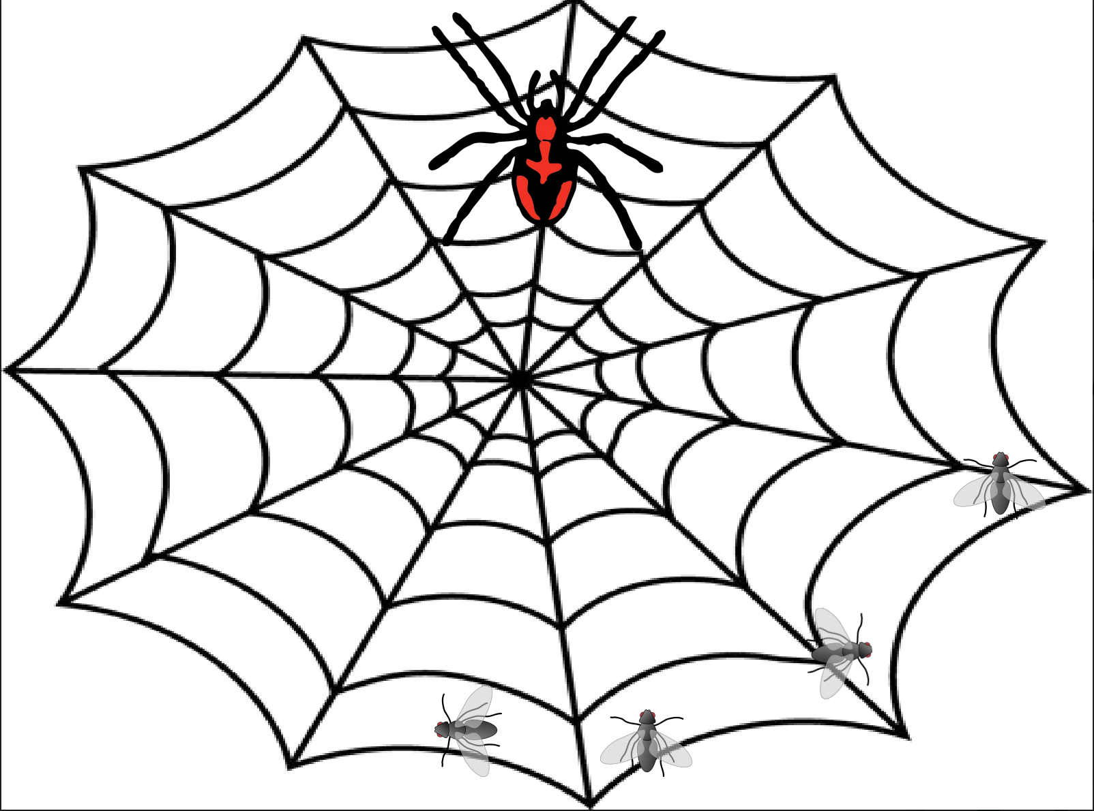

Slide 5


Slide 6


