Slide 1
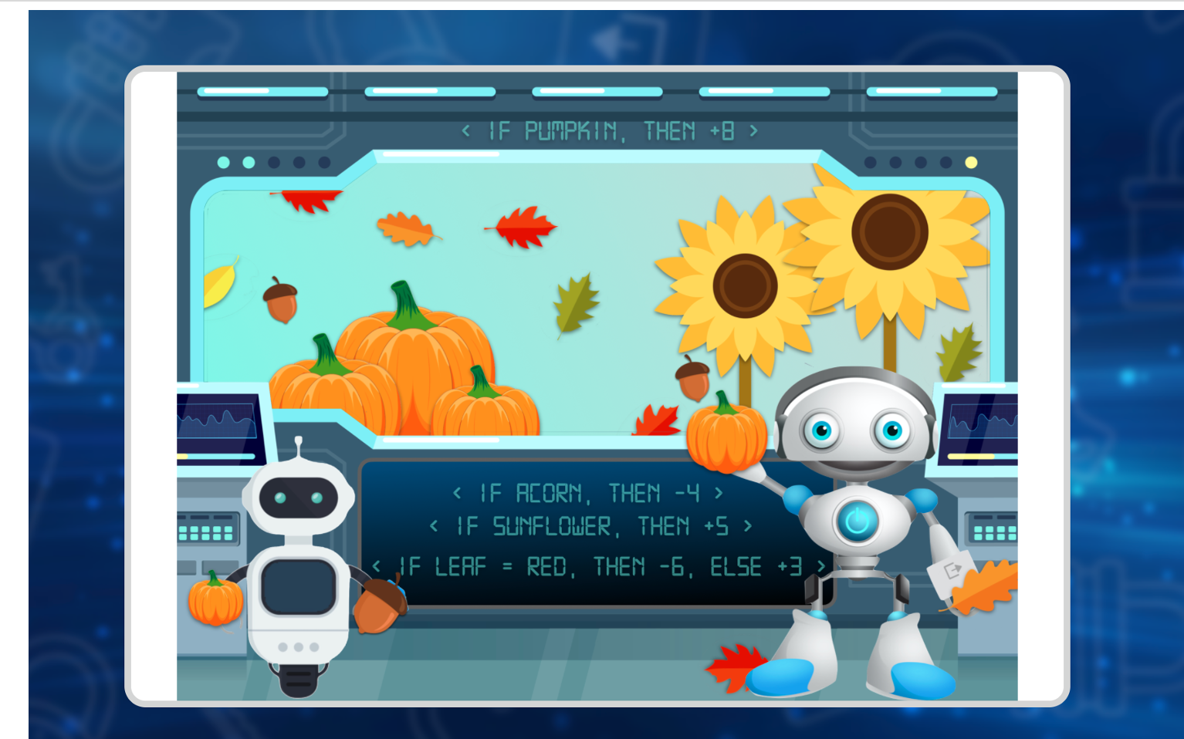
Bonus Puzzle 1 – Fall Robots – a 2digit number

Slide 2
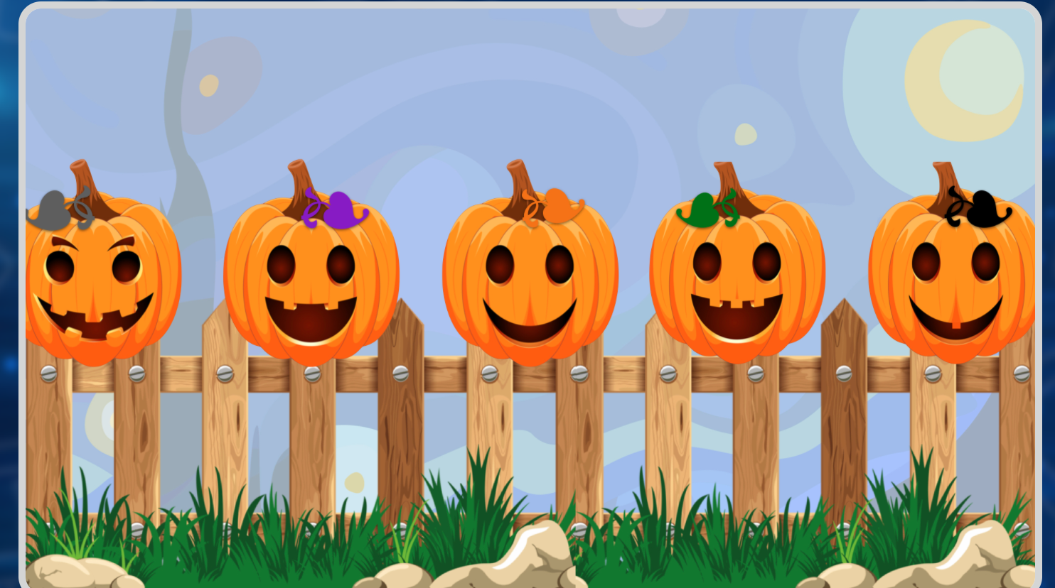
Bonus Puzzle 2 – Pumpkins on a Fence - Answer is 5 words – all colors.

Slide 3
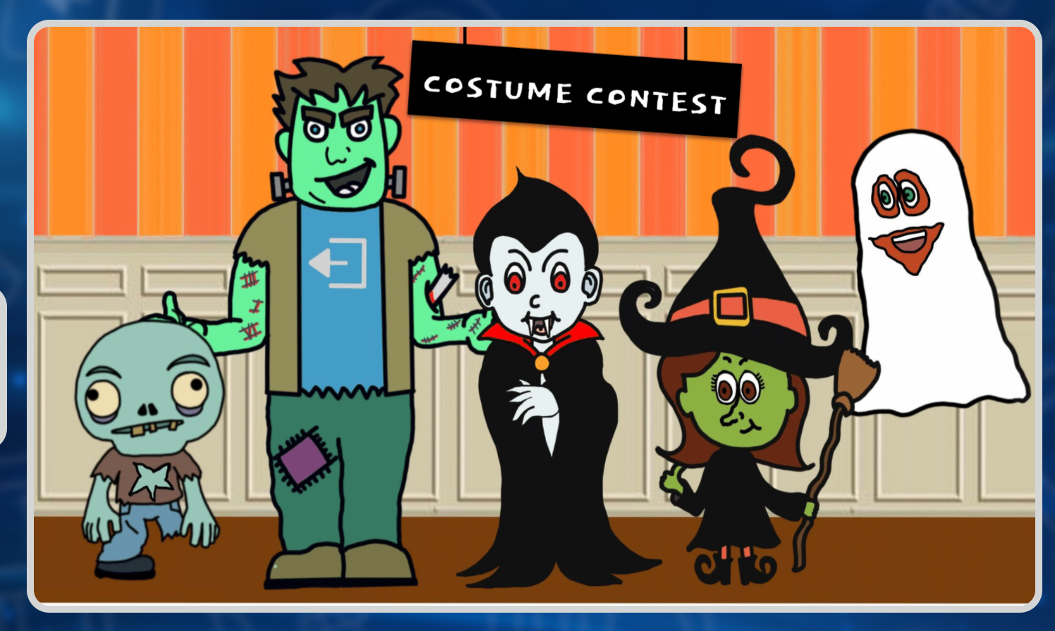
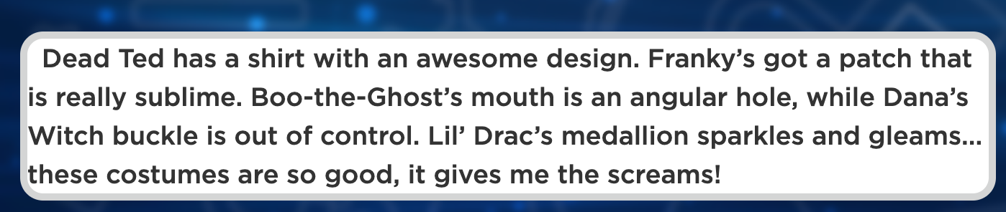
Bonus Puzzle 3 – Costume Contest – 5 word answer – each answer is a shape.
Choices are: circle, square, star, diamond, heart, triangle, octagon

